Slide 1

Future of Sales

Slide 2
Online vs Offline
Nº of Sales Online: 27,659
Sales Online: 32,441,339$
Nº of Sales Offline: 3,806
Sales Offline: 108,266,246$

Slide 3

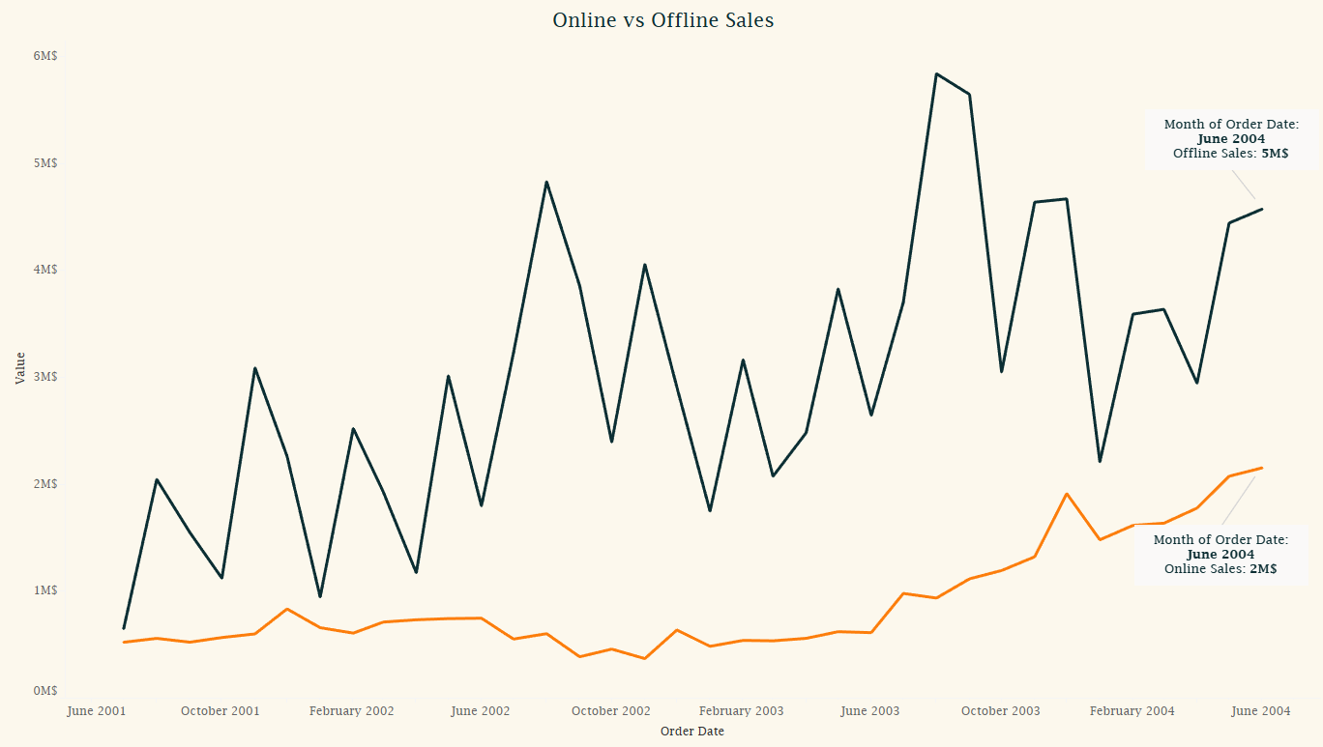

Slide 4
Freight
2,6%

Slide 5
Online
Sales from 2003: 11M$
Sales until June, 2004: 11M$
Projected Sales for 2004: 30M$
AVG GROWTH RATE: 101,62%
Offline
Sales from 2003: 43M$
Sales until June, 2004: 21M$
Projected Sales for 2004: 56M$
AVG GROWTH RATE: 86,84%

Slide 6
Top subcategories (Profitability)
Road Bikes – 26K$
Mountain Bikes – 24K$
Touring Bikes – 12K$

Slide 7
TOP 3 sub-categories (Overall Sales)
Road Bikes (23M$)
Mountain Bikes (15M$)
Helmets (9M$)
TOP 3 sub-categories (Online Sales)
Road Bikes (13M$)
Mountain Bikes (7M$)
Helmets (2M$)

Slide 8
Top subcategories (Area)
Road Bikes
5.58M$ (Australia)
4.79M$ (USA)
1.79M$ (Great-Britain)
Mountain Bikes
3.85M$ (USA)
3.19M$ (Australia)

